Slide 1


CIS1003 Introduction to Cybersecurity [3] Cryptography
Dr David Glance

Slide 2

A unit about cats cybersecurity
https://www.cryptokitties.co/
An example of a Non-Fungible Token
Each digital CryptoKitty is owned by a user validated on the Ethereum blockchain

Slide 3
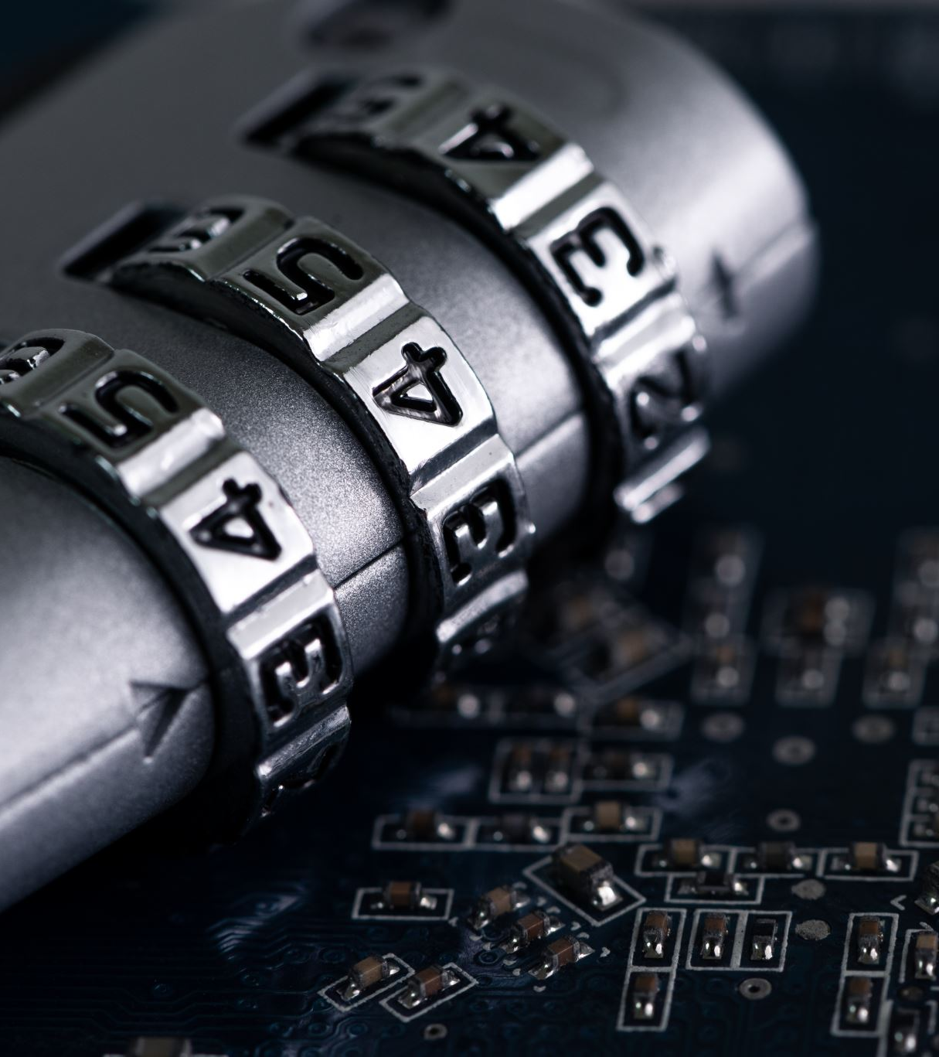

3 things
Understand how cryptography is a control for confidentiality and integrity
Achieving encryption through confusion and diffusion
Managing keys for symmetric and asymmetric cryptography

Slide 4
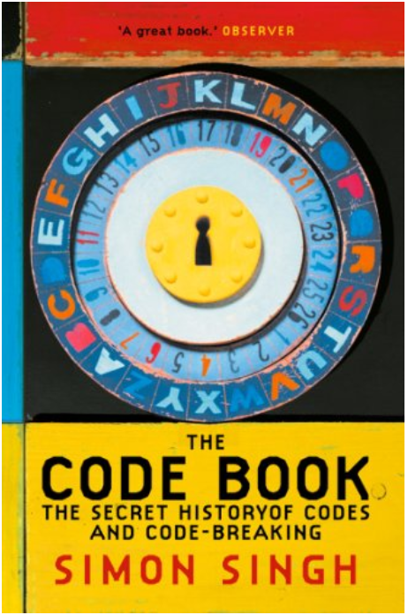
Some History
We won’t start with Julius Caesar (Born 100 BC)
Herodotus (425 BC) The Histories talks about Demaratus warning the Greeks about an impending attack by Xerxes (Persian) – used writing on a board and then covered in wax (Steganography)
Ancient Chinese wrote messages on silk, scrunched and the covered in wax and swallowed!

Slide 5
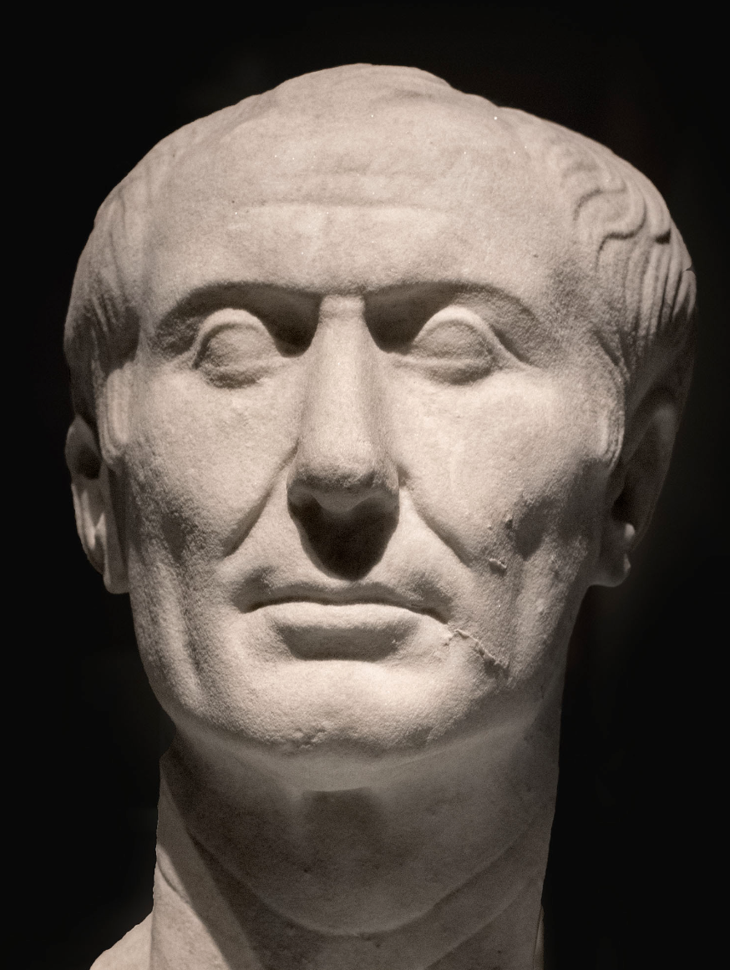
Caesar Cipher
Messages sent by Caesar used a substitution cipher
Replace letters by that letter shifted 3 positions
A → X
B → Y
Plaintext: THE QUICK BROWN FOX JUMPS OVER THE LAZY DOG
Ciphertext: QEB NRFZH YOLTK CLU GRJMP LSBO QEB IXWV ALD
Known as ROT3 (ROTation)
Decipher by right-shifting ciphertext characters 3

Slide 6
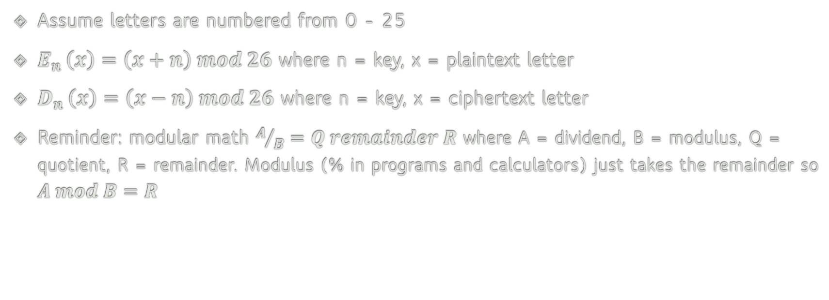
Some simple maths
Assume letters are numbered from 0 - 25
$E_{n }\left(x\right)=\left(x+n\right) mod 26$ where n = key, x = plaintext letter
$D_{n }\left(x\right)=\left(x−n\right) mod 26$ where n = key, x = ciphertext letter
Reminder: modular math $A/B=Q remainder R$ where A = dividend, B = modulus, Q = quotient, R = remainder. Modulus (% in programs and calculators) just takes the remainder so $A mod B=R$

Slide 7
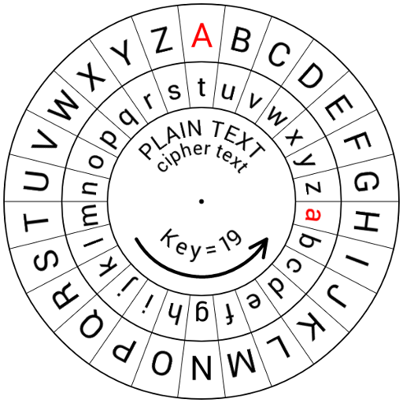
Or an easier approach

Slide 8
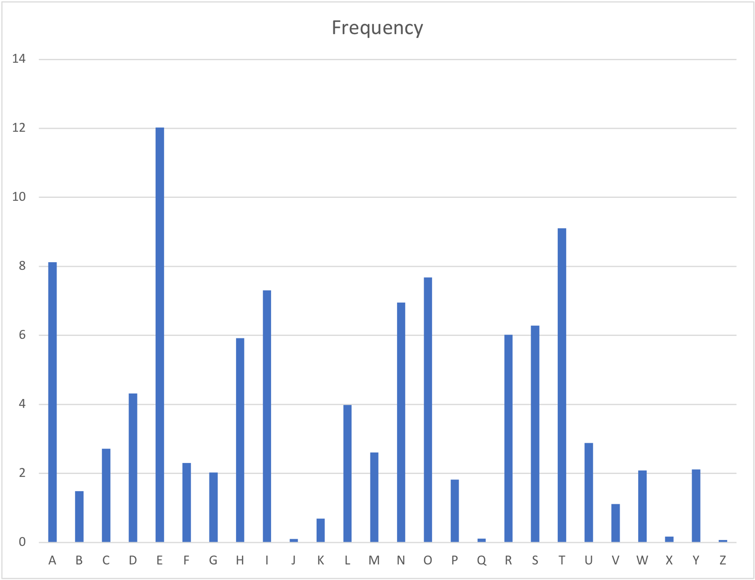
What could go wrong?
For Julius Caesar, the cipher worked, in part because his enemies were mostly illiterate
It can be attacked using cryptanalysis, in this case using:
Brute force: just decrypt using 1 to 25 as the shift and search for meaningful text
Letter frequency – just measure the frequency of the letters in ciphertext and compare to see how much it has shifted

Slide 9
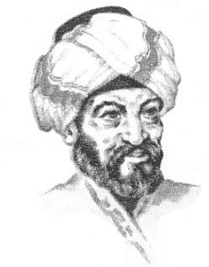
Al-Kindi
Came up with cryptanalysis
Book Manuscript on Deciphering Cryptographic Messages in 870 AD
Not only used letter frequencies but noted that double letters, and 2-,3-letter words occurred with a certain frequency
Michel Bakni https://commons.wikimedia.org/w/index.php?curid=97536463

Slide 10

Cryptology, Ciphers, and Codes
Cryptology is the discipline of study of cryptography and cryptanalysis.
Term derived from Greek Kryptós (hidden) and lógos (word)
Codes are a mapping of one representation of information for another. They operate on the semantic level of information
Morse code turns characters into dots and dashes and also used other codes as abbreviations
Computer codes like ASCII (American Standard Code for Information Interchange) and Unicode
U+1F600 =
Ciphers are algorithms that operate on syntax and are semantic agnostic
Caesar cipher

Slide 11
Polyalphabetic Cipher
Substitution cipher using multiple substitution alphabets
Vigenère cipher was invented by Giovan Battista Bellaso in 1553
Misatributed to Blaise de Vigenère
Works by using a repeating key word: letters are shifted by the number code of the letter in the key
Plaintext | H | A | C | K | I | N | G | I | S | F | U | N
Code | 7 | 0 | 2 | 10 | 8 | 13 | 6 | 8 | 18 | 5 | 20 | 13
Key | C | A | T | S | C | A | T | S | C | A | T | S
Shift | 2 | 0 | 19 | 18 | 2 | 0 | 19 | 18 | 2 | 0 | 19 | 18
Ciphertext | J | A | V | C | K | N | Z | A | U | F | N | F

Slide 12
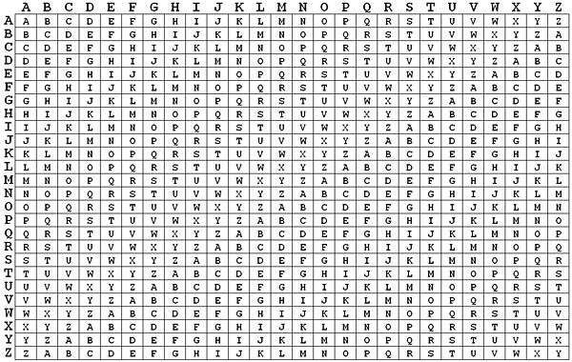
Vigenère Table
Basically a series of Caesar ciphers
To use, find the letter of the plaintext along the top row and the corresponding letter of the key on the side column and take the letter that intersects

Slide 13
Breaking Vigenère
Because there are multiple possible ciphertext letters for each plaintext letter, frequency analysis is not possible
Friedrich Kasiski (1863) developed an attack strategy:
Find repeated use of the same key to estimate the key length
Plaintext: CRYPTOISSHORTFORCRYPTOGRAPHY
Key: ABCDABCDABCDABCDABCDABCDABCD
Ciphertext: CSASTPKVSIQUTGQUCSASTPIUAQJB
The repetitions are 16 characters apart and so the key length is 16,8,4,2 or 1
Once you have the key length, then look at frequency analysis of the individual Caesar ciphers
Other attack strategies: Friedman’s (kappa) test, Kerchoff’s method

Slide 14
One-Time Pads
Longer “shift words” and shorter messages make frequency analysis more difficult and making it harder it is to crack a message
A one-time pad is a list of random shifts; selected shift sequence must be longer than your message
This is uncrackable , because of 2 important properties
Shifts will never fall into a pattern (because pad is longer than message)
Frequency distribution is uniform (because shifts are random)
One-Time Pads are known as being “Perfectly Secure” as defined by Claude Shannon in 1949 (Shannon, C. (1949) Communication Theory of Secrecy Systems. Bell System Technical Journal 28) https://netlab.cs.ucla.edu/wiki/files/shannon1949.pdf
Principle is that if the key is perfectly random, the potential number of encrypted messages is the same as the number of potential keys and the number of messages
However, pseudo-random keys will result in a repeating pattern of keys and so a smaller subset of encrypted messages

Slide 15
One-Time Pads
Practical limitations
You need to have a large number of random keys
You need to distribute these keys to the senders and receivers
You need to protect them from discovery
Key distribution and protection a general problem even with modern systems
Public Key Infrastructure (PKI) as we will see later

Slide 16
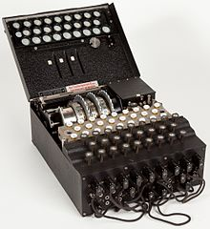
The Enigma Machine
Invented by the German army at the end of WW1 and further developed during WW2
Consists of a plug board that switches letters A→F, G→K, L→M and a set of 3 (or more) rotors chosen from a larger set) with 26 positions on each rotor.
Start by sharing
Plug board settings
Set of rotors
Ring settings
Initial position
Each time a character is typed, the rotor turns and the characters on each rotor are added together to form the substitution
Check out emulator https://www.101computing.net/enigma-machine-emulator/

Slide 17
Transposition
In transposition, we change the order of characters in the ciphertext without making substitution
One method:
Take the message “nowrunalonganddontgetintomischiefimgoingout”
We pad it with 4 xxxx and arrange as a grid:
We can now take the columns to create the ciphertext
nnog odmo wdii rosh uncg ntho agiu leet otfx niix gnax atmx
n o w r u n a l o n g a
n d d o n t g e t i n t
o m i s c h i e f i a m
g o i n g o u t x x x x

Slide 18
Confusion and Diffusion
Claude Shannon (1945) A Mathematical Theory of Cryptography
Confusion
Each part of the ciphertext depends on several parts of the key
Hides the relationship between ciphertext and key
Diffusion
Change in plain text will result in larger changes in ciphertext
Hide the relationship between the ciphertext and plaintext
We can achieve confusion/diffusion using a combination of substitution/transposition (permutation) and we will see how this is used in modern ciphers.

Slide 19
Computers and Ciphers
Text in computers are represented as ASCII (or Unicode) code
Letter ‘a’ is 97 in decimal, 61 in hexadecimal and 1100001 in binary
When we encrypt text on a computer we can take the key’s binary and then do logical operation (AND, OR, XOR) using the key on the plaintext
AND
OR
XOR
p | k | c
1 | 1 | 1
1 | 0 | 0
0 | 1 | 0
0 | 0 | 0
p | k | c
1 | 1 | 1
1 | 0 | 1
0 | 1 | 1
0 | 0 | 0
p | k | c
1 | 1 | 0
1 | 0 | 1
0 | 1 | 1
0 | 0 | 0

Slide 20
Computers and Ciphers
To encrypt the letter ‘a’ with the letter ‘t’ we could do an ‘AND’, ‘OR’ or ‘XOR’ operation
1100001 AND 1110100 = 1100000 (hex 60 or “`”)
1100001 OR 1110100 = 1110101 (hex 75 or “u”)
1100001 XOR 1110100 = 0010101 (hex 15 or non-printable character)

Slide 21
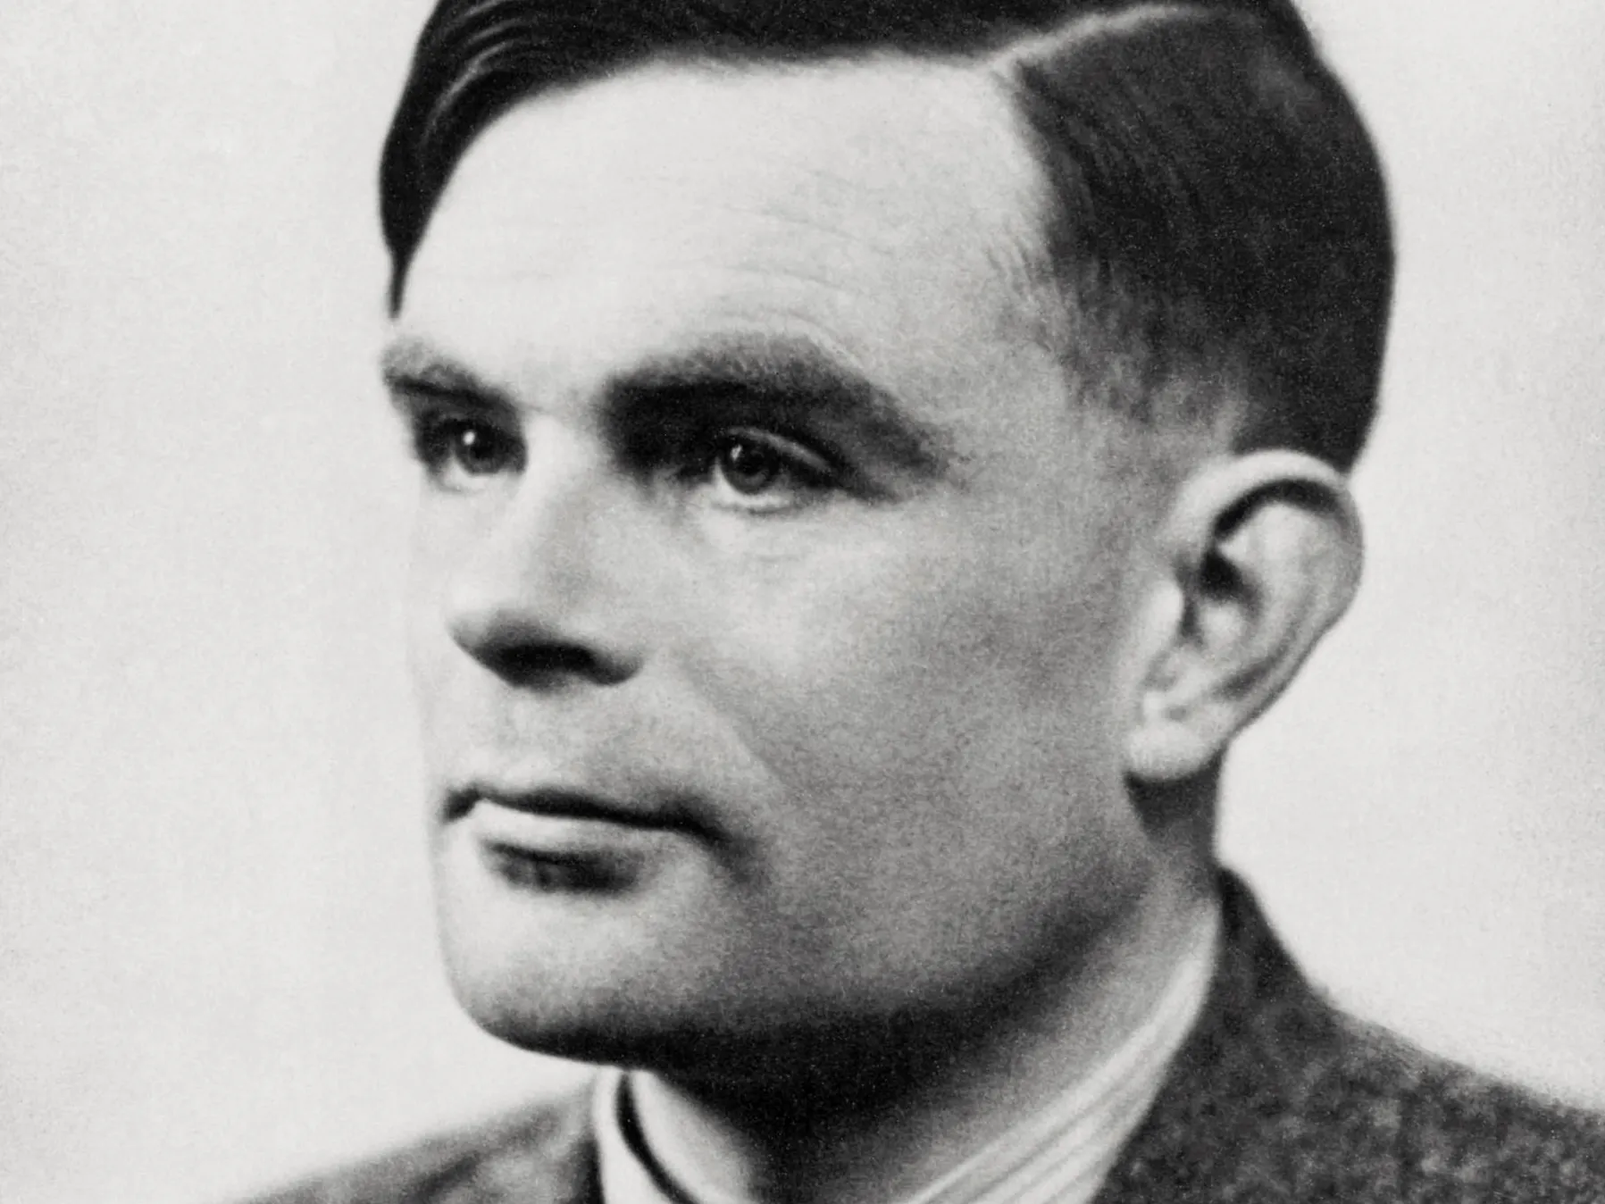
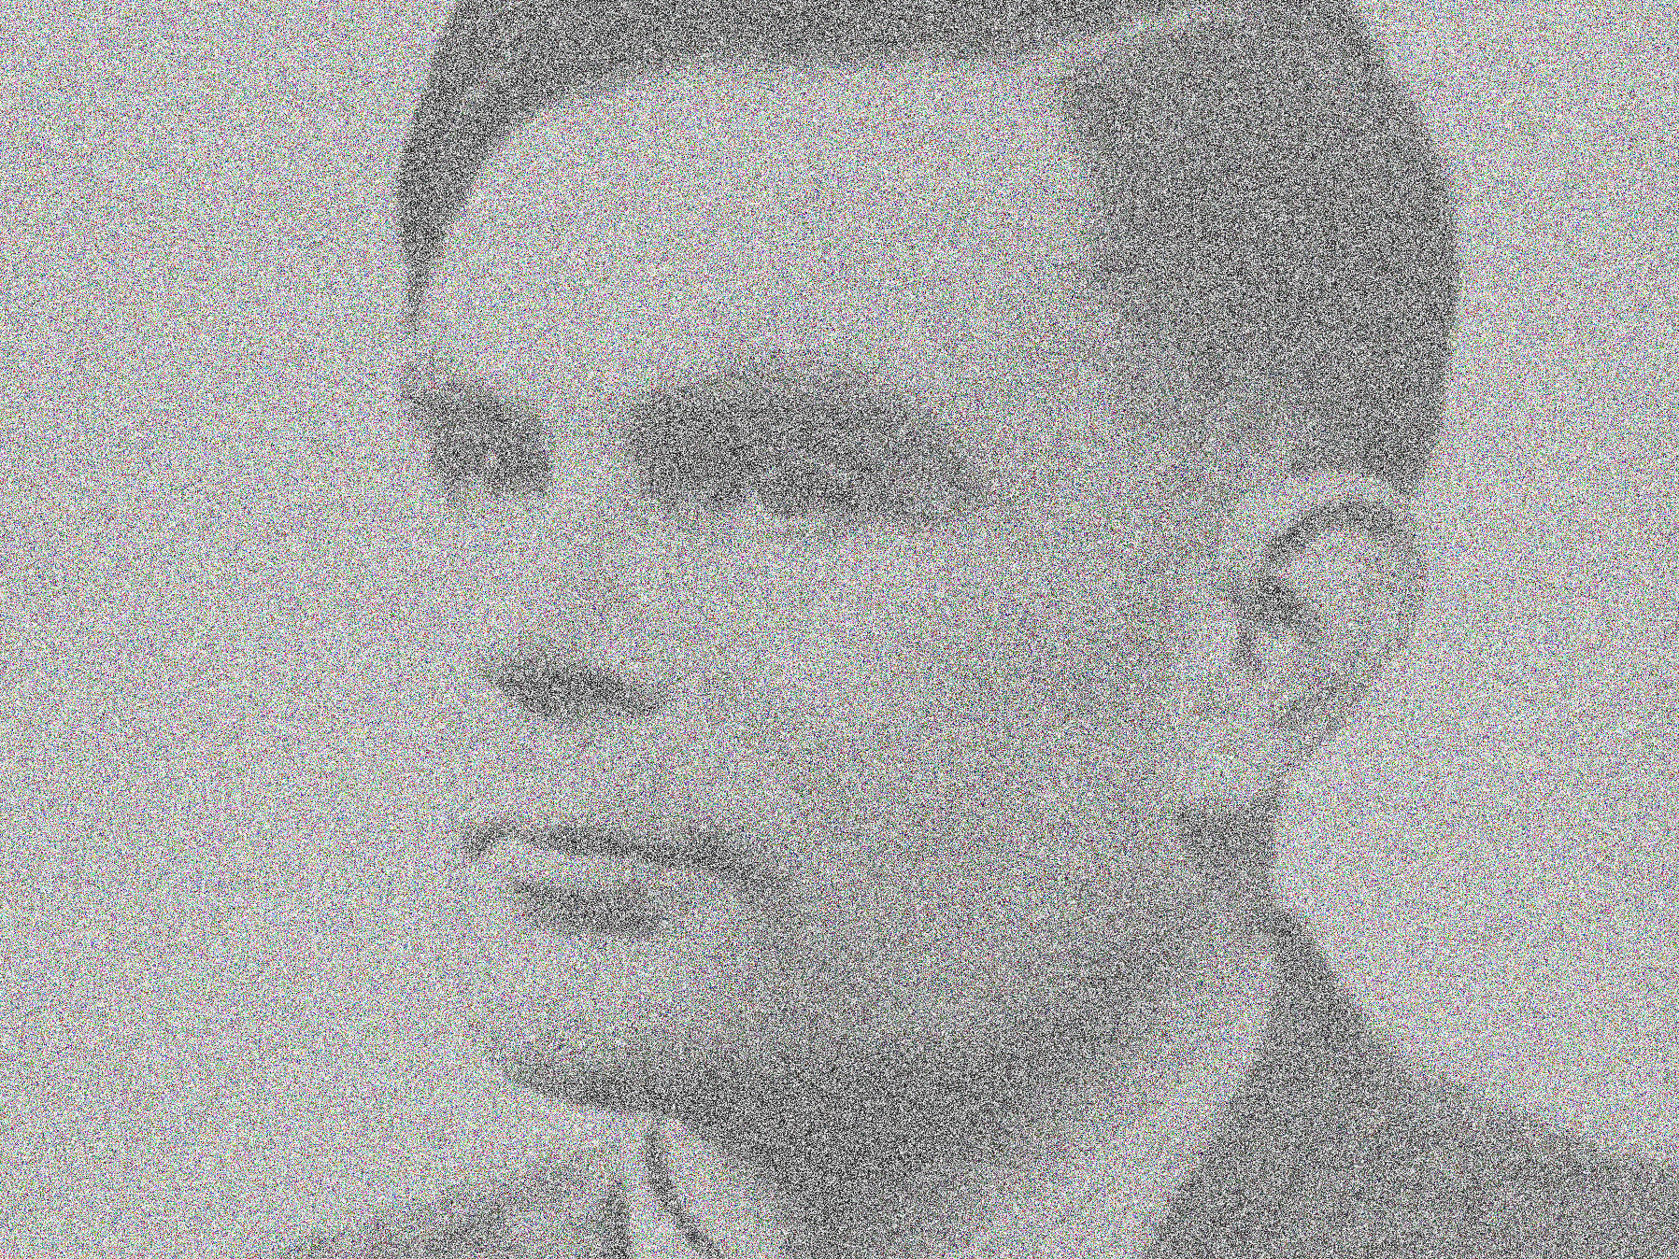
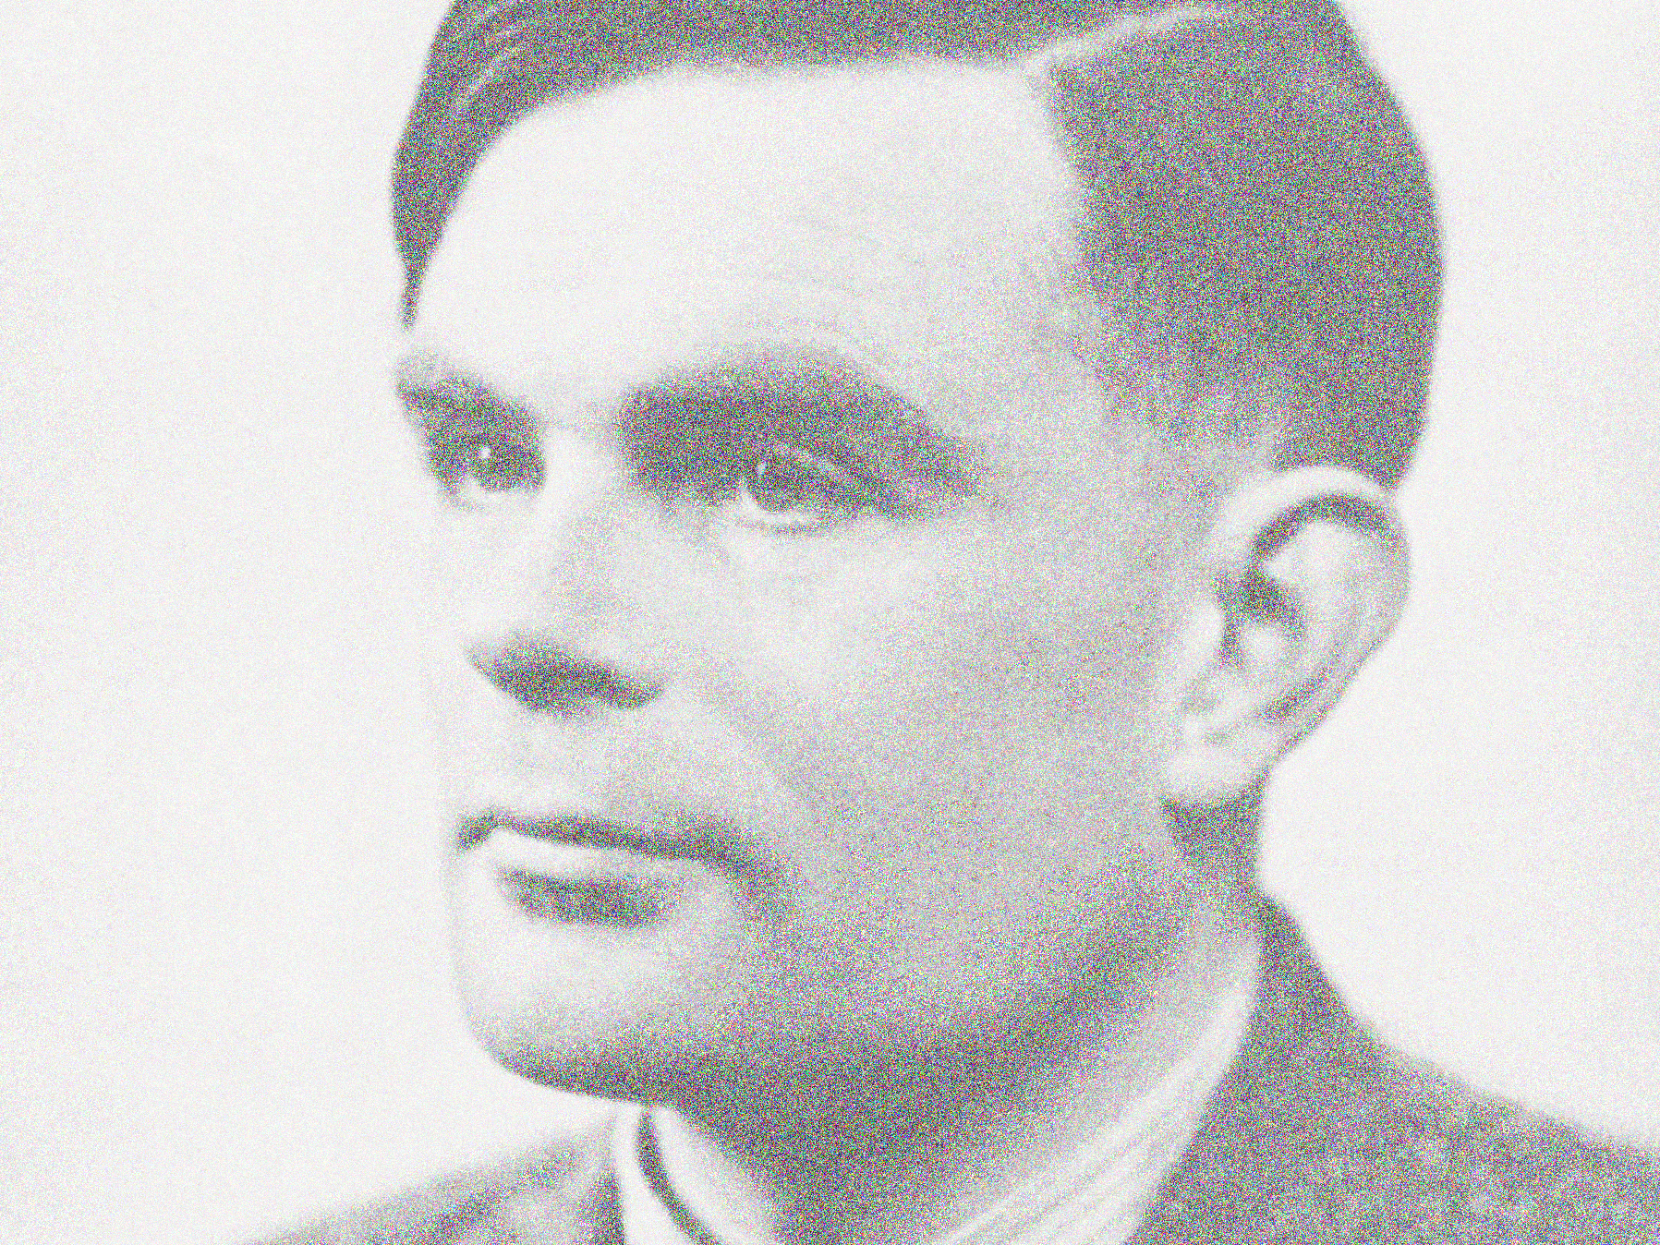

Why we use XOR
Using a one-time pad to encrypt on a computer is best done using an XOR operation.
To see why: take an image which is represented by bits. Take a string of random bits and do an AND, OR and XOR
Original
AND
OR
XOR
Images courtesy of https://www.biography.com/scientist/alan-turing encryption by Alex Brownhttps://github.com/Ccamm/Basic-Image-Encryptor

Slide 22











Why we use XOR
If we look at outcomes for AND, OR and XOR of 2 binary bits, OR and AND have a higher chance of leaving things unchanged in the cipher text
AND P(p) = 0.75
OR P(p) = 0.75
XOR P(p) = 0.5
p | k | c
1 | 1 | 1
1 | 0 | 0
0 | 1 | 0
0 | 0 | 0
p | k | c
1 | 1 | 1
1 | 0 | 1
0 | 1 | 1
0 | 0 | 0
p | k | c
1 | 1 | 0
1 | 0 | 1
0 | 1 | 1
0 | 0 | 0
Notes:
T

Slide 23
Cryptography Today
Two types of encryption used:
Symmetric key cryptography: Both parties share the same single key
Asymmetric key cryptography: Each party has 2 keys: public key and private key
Both types or encryption are used for different purposes and have different benefits and drawbacks
In addition to the above, there are other cryptographic functions that do not require a key e.g. Hash functions

Slide 24
Symmetric Key Cryptography
Modern (digital) ciphers arose with the need for encryption in digital systems
Of two types: Block and Stream which differ in how the plaintext is handled
Block ciphers take chunks of the plaintext and manipulates them to encrypt
Stream ciphers encrypts data as a stream of bytes
Data Encryption Standard (DES) becomes first US national standard algorithm in 1976
Invented by IBM and originally called Lucifer which was based on Feistel cipher
Mired in some controversy because of the involvement of the US National Security Agency (NSA) in the design and decision about the key length

Slide 25
DES
Block length is 64 bits
Key length is 56 bits (64 bits with 8 bits as parity)
The process for encryption involves:
Key schedule
Subkeys are generated from the key for 16 rounds of application to the plaintext
Permutations (diffusion) by initial expansion through duplication and mixing outputs at the end of each round
Substitutions: using S-boxes which are lookup tables that take 6 input bits and output 4 output bits
Not overly important to know the details

Slide 26
DES (and other block ciphers) Modes
The previous description details how a single block of plaintext is encrypted but what about a sequence of blocks?
Some take an Initialisation Vector (IV) which is a
Different modes of encrypting a sequence of blocks:
ECB (Electronic Codebook): Each block is encrypted independently
CBC (Cipher Block Chaining) Each encrypted block is XOR’d with the next block. Start with the IV
CFB (Cipher Feedback) Same mechanism as CBC but operates as a stream of real time data
OFB (Output Feedback) Same as CFB but uses the IV and encrypted versions of the IV as input to successive blocks
CTR (Counter) Same as OFB but uses a simple counter to alter seed input to each encryption

Slide 27
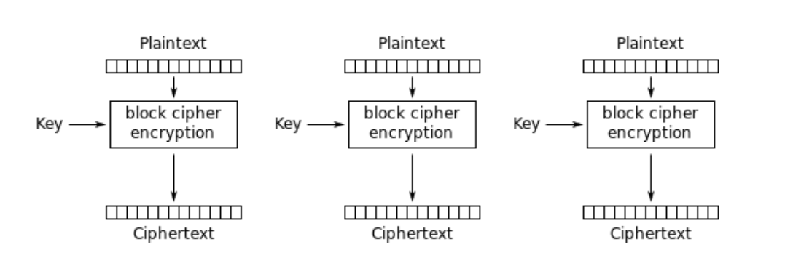
ECB Mode
ECB (Electronic Codebook): Each block is encrypted independently

Slide 28
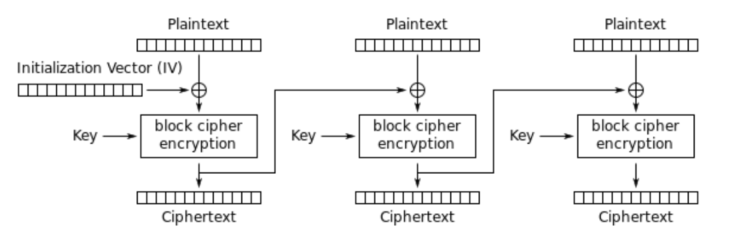
CBC Mode
CBC (Cipher Block Chaining) Each encrypted block is XOR’d with the next block. Start with the IV

Slide 29
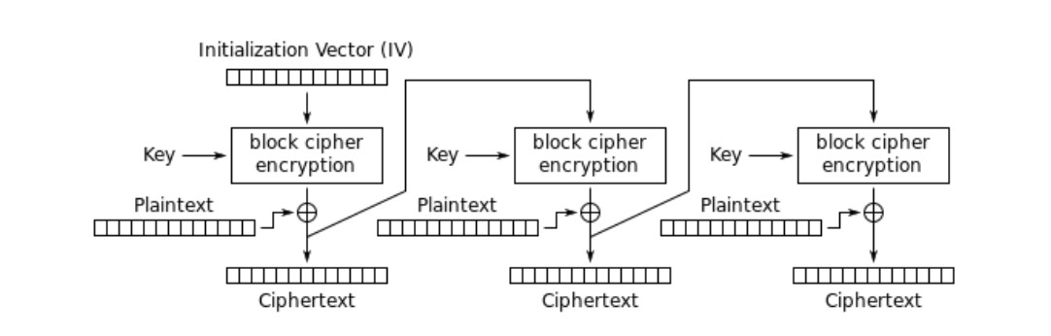
CFB Mode
CFB (Cipher Feedback) Same mechanism as CBC but operates as a stream of real time data

Slide 30
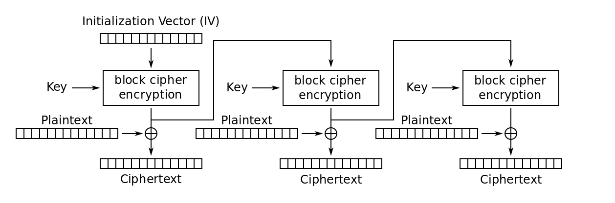
OFB Mode
OFB (Output Feedback) Same as CFB but uses the IV and encrypted versions of the IV as input to successive blocks

Slide 31
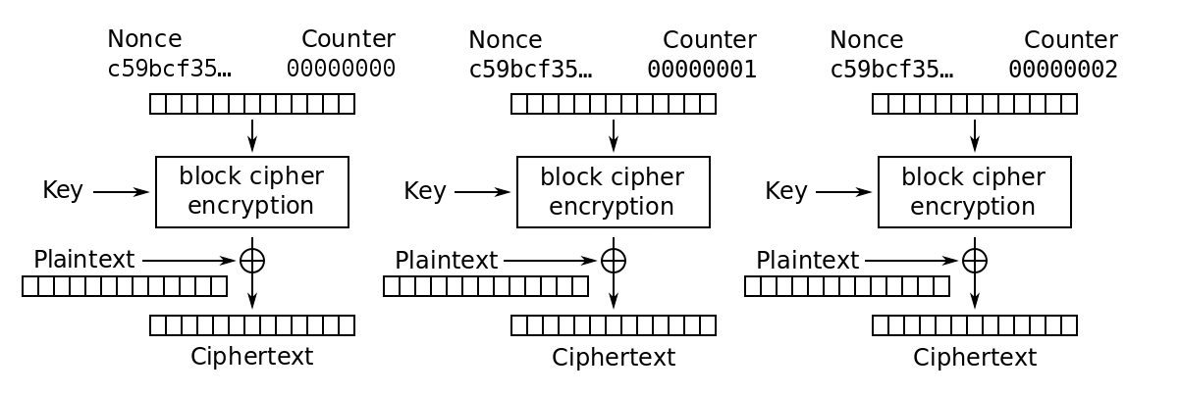
CTR Mode
CTR (Counter) Same as OFB but uses a simple counter to alter seed input to each encryption

Slide 32

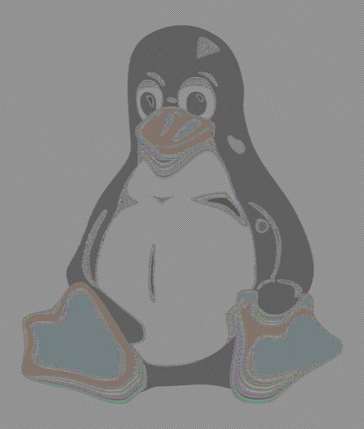
Pros and Cons of Modes
ECB leaks information ECB Tux Penguin. This is because the same plaintext block will generate the same ciphertext
ECB penguin Filippo Valsorda (https://blog.filippo.io/the-ecb-penguin/) Original image Wikipedia https://commons.wikimedia.org/wiki/File:Tux.jpg

Slide 33
Pros and Cons of Modes
CBC and CFB mode propagates errors and this will corrupt attempts to decrypt
OFB does not propagate errors in blocks
ECB and CTR can be parallelized and so are fast

Slide 34
DES is broken
The DES key length became a liability and DES was cracked by brute force in 1997
Brute forcing by going through all possible keys takes at most 2⁵⁶ attempts
Using a Nvidia 3090 GPU you could to this in about 166 days
You can parallelise it with more GPUs and do it faster
1997: DESCHALL Project (parallel computing) -> 96 days
1998: EFF’s DES cracker -> 56 hours
2006 COPACOBANA FPGA hardware – around 6.4 days
2017: chosen-plaintext attack with rainbow table of all 2⁵⁶ ciphertext -> 25 seconds!
Just using a large GPU machine on AWS and hashcat would do DES in about a day.

Slide 35
3DES and AES
The solution to DES was to do it 3 times in a row and this became 3DES (Triple DES)
Don’t do 2DES (Double DES) because it is vulnerable to a meet-in-the-middle attack
Won’t go through details but it makes it not much better than DES
Variants of 3DES depending on number of keys used and whether you use 3 encryptions (EEE) or encryption, decryption, encryption (EDE)
In the meantime, Advanced Encryption Standard adopted by US NIST in 2000. Based on the Rijndael scheme.
128 bit block length
Keys of
128 bits with 10 rounds of encryption
192 bits with 12 rounds of encryption
256 bits with 14 rounds of encryption

Slide 36
Public Key Cryptography
1874 William Stanley Jevons wrote in The Principles of Science:
“Can the reader say what two numbers multiplied together will produce the number 8616460799? I think it unlikely that anyone but myself will ever know.”
Illustrates a principle that factorisation is hard but the factors are 89681, 96079
In 1977, MIT researchers Ron Rivest, Adi Shamir and Leonard Adleman came up with RSA
Key Generation: Create a public and private key. Public key is shared, private key is kept secret
Encryption: Encrypt a message to someone with their public key
Decryption: Decrypt a message with the private key

Slide 37


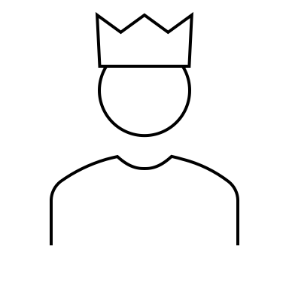


Public Key Cryptography
Alice
Bob
Bob’s Public Key
Bob’s Private Key
Encryption
Decryption
Plaintext
Ciphertext
Plaintext

Slide 38
Non-Repudiation
To prove that Alice was the one that sent the message
Alice encrypts the document with her private key and Bob decrypts it with Alice’s public key
It must be Alice because only she would have her private key
This also authenticates Alice
In practice, we don’t need to encrypt the entire document but can do a hash of the document

Slide 39
Non-Repudiation
Alice
Alice’s Private Key
Alice’s Public Key
Bob
Encryption
Decryption
Plaintext
Ciphertext
Plaintext

Slide 40






Alice
Bob
Bob’s Public Key
Bob’s Private Key
Encryption
Decryption
Plaintext
Alice’s Private Key
Alice’s Public Key

Slide 41
Confidentiality and Authentication
Combine the two processes
Alice encrypts the document with her private key
Alice then encrypts again with Bob’s public key
Bob decrypts the document with Bob’s private key
Bob decrypts the document with Alice’s public key

Slide 42
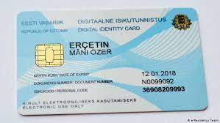
Asymmetric Cryptography: Public Key Distribution
Distributing public keys is much easier than sharing private keys amongst people
However, still have an issue about verifying that a public key belongs to the person it says
Decentralised models: PGP, OpenPGP
Centralised models: Estonian ID-Card
PGP (Pretty Good Privacy) Phil Zimmerman 1991
Uses variety of symmetric and public key ciphers
Uses Web of Trust
Estonian model needs proof of identification (passport, driving license, etc) also can only be collected in person

Slide 43
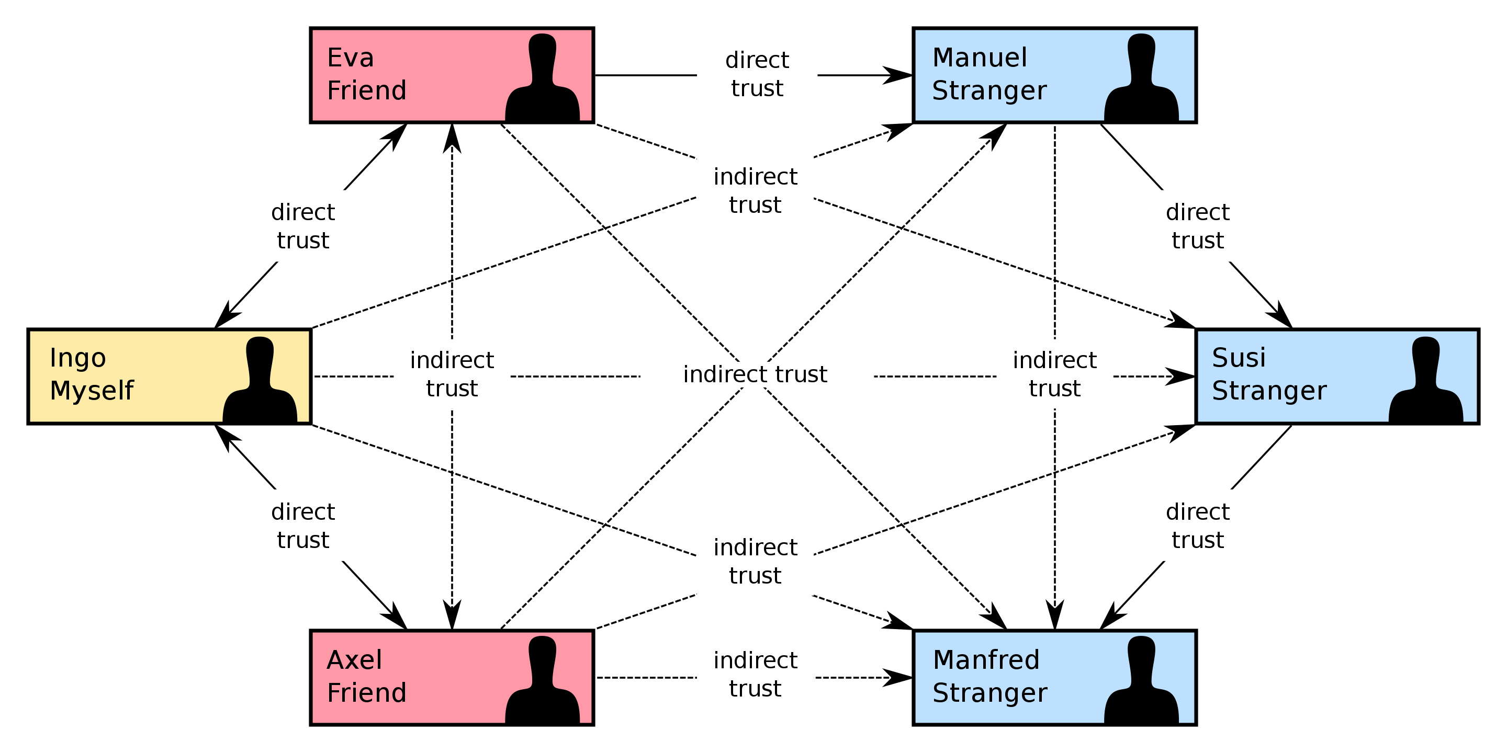
Web Of Trust
Relies on validation through a network of people you trust
Ideally however this is verified in person
Can have indirect trust if someone you trust, directly trusts another person
In practice this simply doesn’t work
It can be manipulated
It is too hard to do the due diligence
A version of this can be used with trusted third parties (but that isn’t peer-to-peer)

Slide 44
Public Key Infrastructure
Trusted 3rd party or internal system that certifies through a certificate that a public key belongs to an individual
Known as the Certificate Authority (CA)
CA delegates authority to identity verification to a Registration Authority (RA)
Certificates held in database and can be checked for validity
Certificate policy: specifies architecture, what certificates can be used for, security controls, etc.
We will cover certificates in detail later

Slide 45
Cryptographic Hash Functions
Algorithm that maps data of arbitrary size to a bit string of a fixed size
Designed to operate only one way (can’t be inverted)
Properties:
deterministic - the same message results in the same hash
fast to compute
very difficult to generate a message from its hash
small changes to message result in large changes to hash
two different messages are very unlikely to generate the same hash
MD5 was invented by Ron Rivest in 1992 and very common but proved flawed
SHA-2 recommended now although it comes from the NSA – can output various sizes of hash (224, 256, 384 and 512 bits)
SHA-3 released by NIST in 2015

Slide 46
Hash Functions: Password storage
Used for password storage and verification
Password + Salt (random bytes) is hashed and the hash stored for verification
Never store the plaintext
Linux stores passwords in a file called shadow:
openssl passwd -6 -salt randomtext mysecretpassword
$6$randomtext$SqJRpIQLI4zewKY2NPupGyKBZpzND3yl7sbqi1qachbATjFBafjHeQqfzvAeSS2FKb7WuJWV/SSCWD/lba7G//
In practice, Linux will do the hash 5000 times in an attempt to stop brute forcing passwords

Slide 47
Hashing functions
Message Authentication Codes (MAC): message is combined with key and hashed
confirms that a message has not been changed
provides data integrity and authenticity
Digital signature
proposed by Diffie and Hellman in 1976
Digital Signature Algorithm (DSA) part of NIST’s Digital Signature Standard (DSS)
Message is hashed and then processed using the private key to produce a signature
Checking the signature involves taking the hash of the message and the signature and using the public key to verify the signature.
https://oag.ca.gov/sites/all/files/agweb/pdfs/erds1/fips_pub_07_2013.pdf

Slide 48
Key Exchange
Public key cryptography is slow and so is still not used for real-time encryption of communications
Merkle, Diffie and Hellman published papers in 1976/7 on a method of exchanging public keys securely (known as the Diffie-Hellman Key Exchange
Once the keys are exchanged, a secret key can be generated and shared to do symmetric encryption.
We will see later that this is the basis for TLS which gives the web secure communication through HTTPS.

Slide 49
Key Exchange Walkthrough
Alice chooses 2 prime numbers g and p and tells Bob what they are.
Bob picks a secret number (a), and computes gª mod p and sends that result (A) back to Alice
Alice picks a secret number (b), and computes g^{b} mod p and sends that result (B) back to Bob
Bob takes B and does same operation with it. Bª mod p.
Alice takes A and does the same operation with it. A^{b} mod p.
The numbers resulting from 4 and 5 are the same!
This session key can be used to encrypt private key

Slide 50
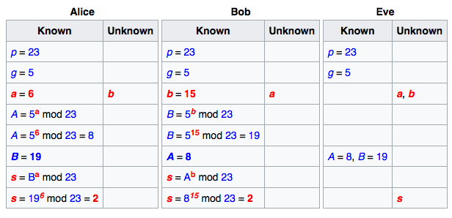
Worked Example

Slide 51
Diffie Hellman Vulnerability
Diffie-Hellman is vulnerable to a man in the middle attack (MITM)
An attacker simply inserts themselves into the communication and acts as a proxy
It is vulnerable because there is no authentication of the parties
Can be mitigated by using signatures as proof of identity

Slide 52
Summary
We have covered the fundamentals of cryptography that consist of using a key and cipher to apply confusion and diffusion to plaintext to generate ciphertext
We looked at examples of modern cryptography and how this has developed to create fast and efficient ciphers
We looked at the way key management could be handled in he case of both symmetric and asymmetric cryptography

